Slide 1

FIRE DETECTOR 101
PRESENTED BY GR.12

Slide 2

COMPONENTS
NODE MCU ESP8266
01
SENSORS
02
IR Flame Detector Sensor
MQ-2 gas sensor

Slide 3
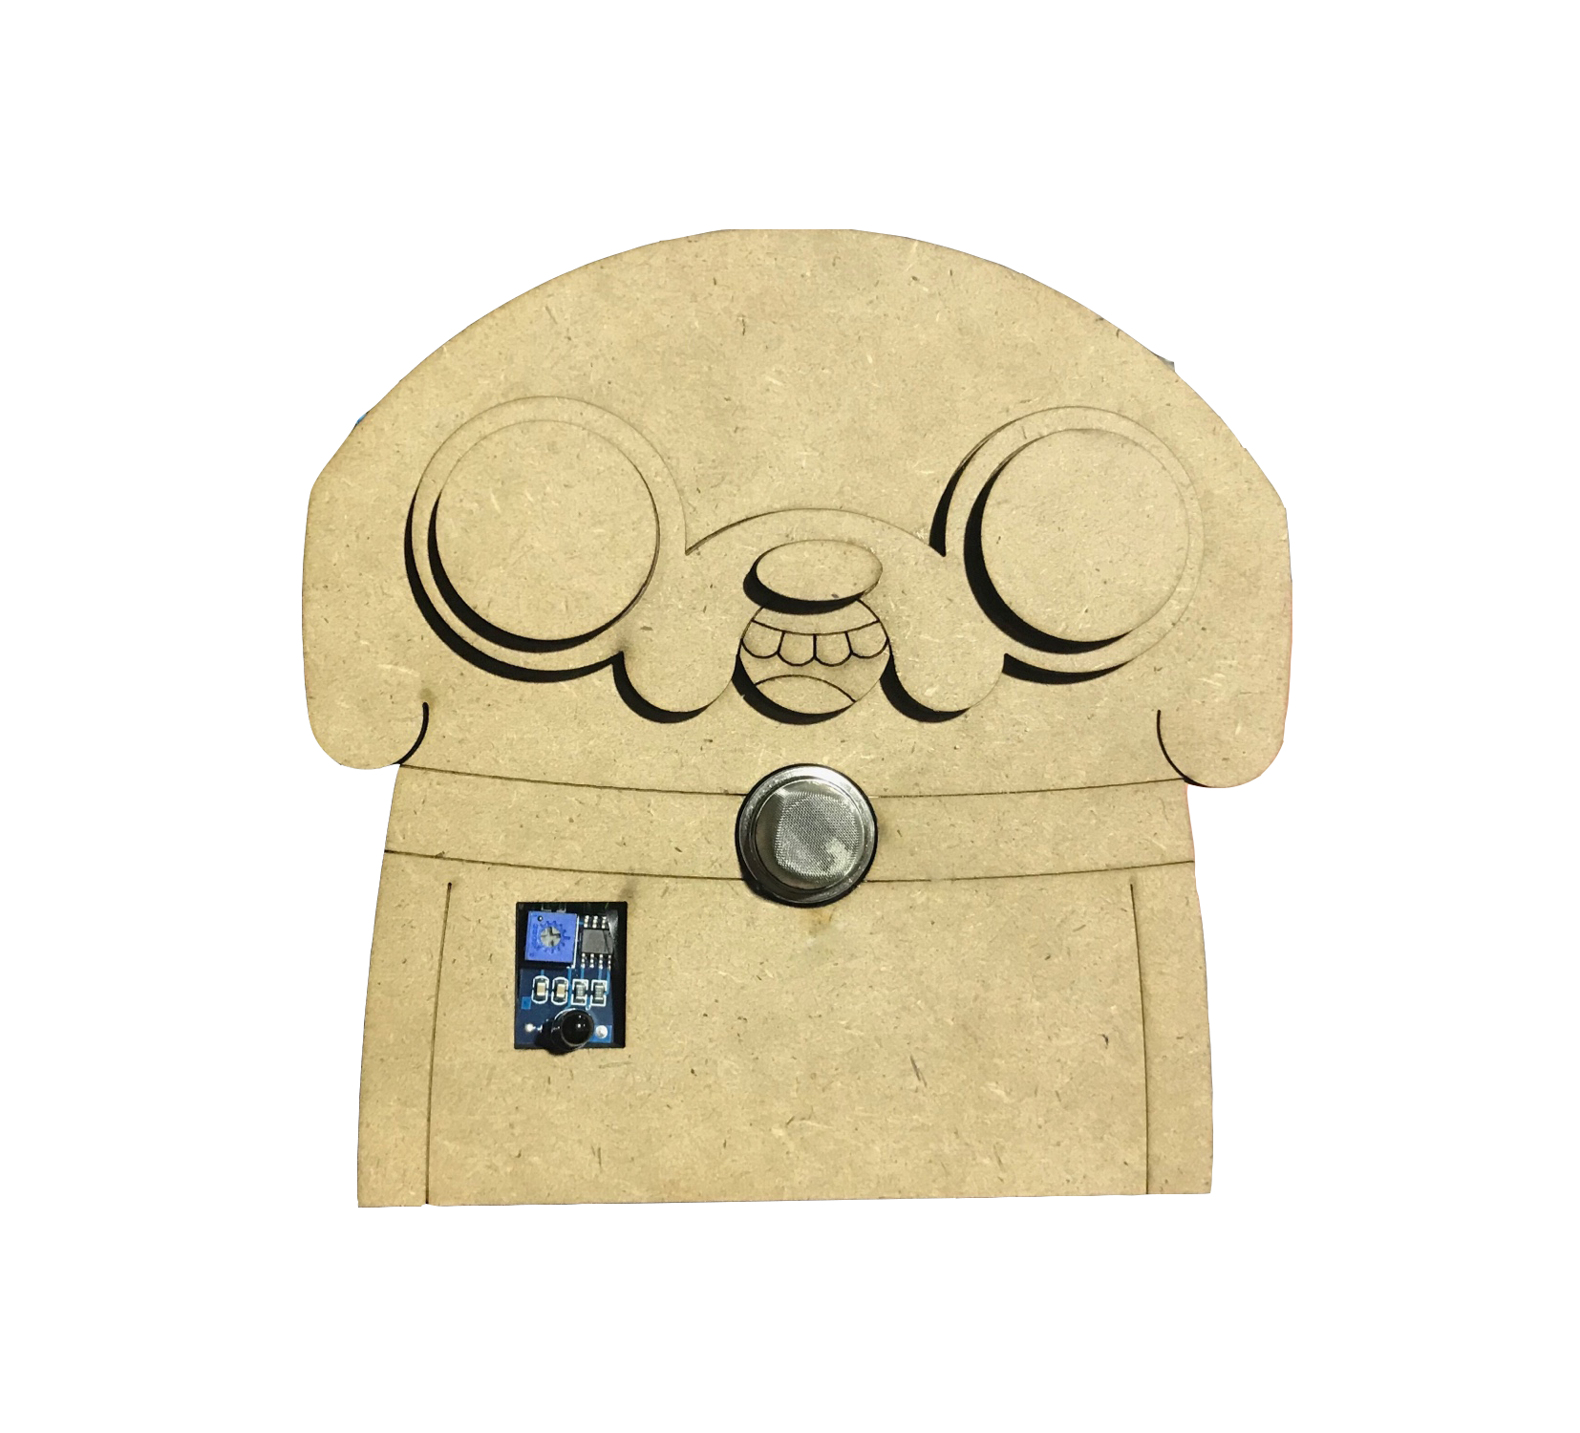
DESIGN
Our product design had inspiration from the character “Jake” in Adventure Time, the animated television series.

Slide 4
HOW IT WORKS
Detect smoke/flame, then sending messages via LINE to personal’s account or to rescue’s official account.

Slide 5
RISK LEVELS
LEVEL 1: Detect either smoke or flame
LEVEL 2: Detect both smoke and flame

Slide 6
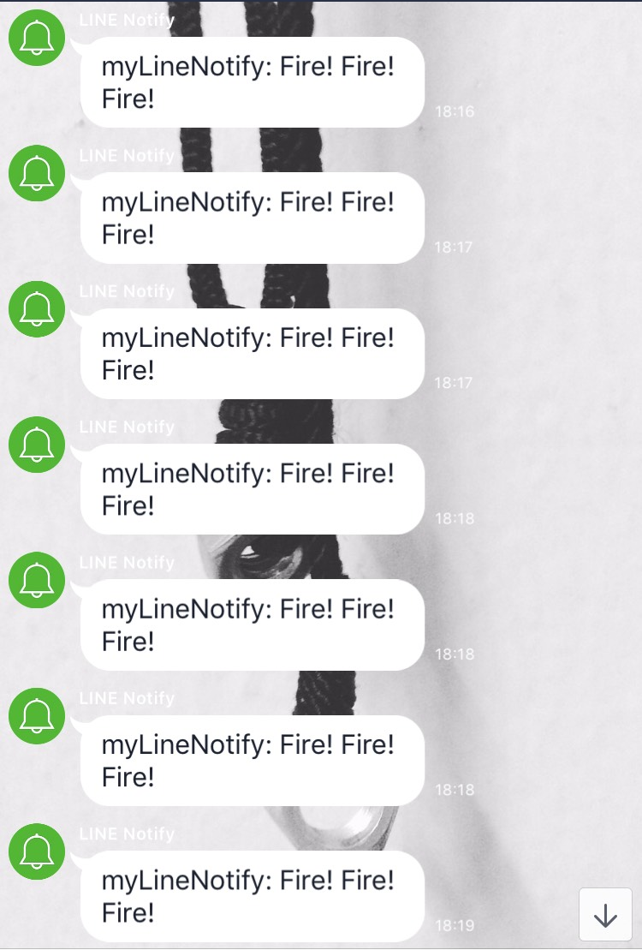
LEVEL 1
Only send alert messages to personal account

Slide 7
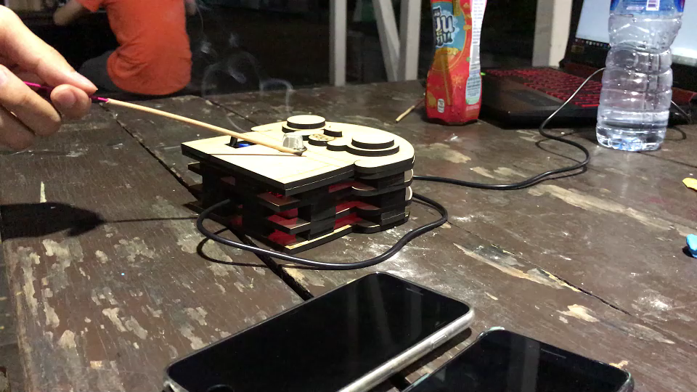
Case 1: Detect only smoke

Slide 8
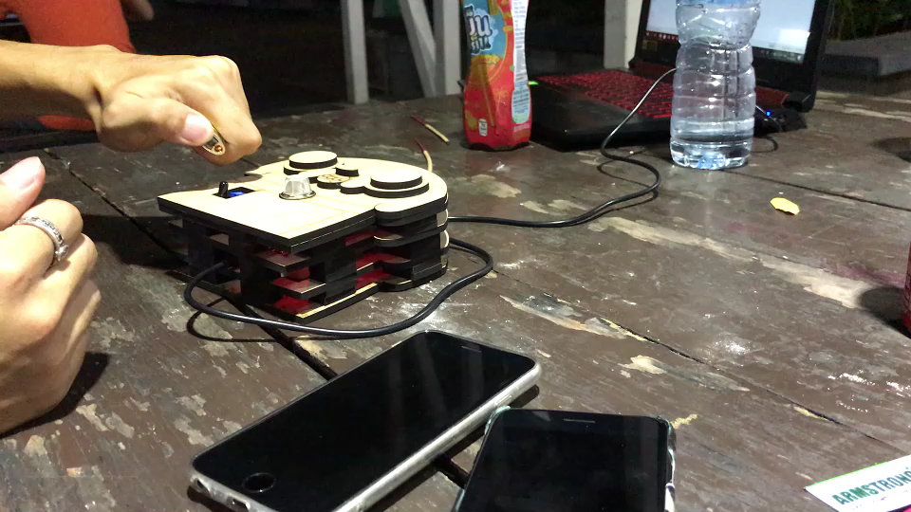
Case 2: Detect only flame

Slide 9
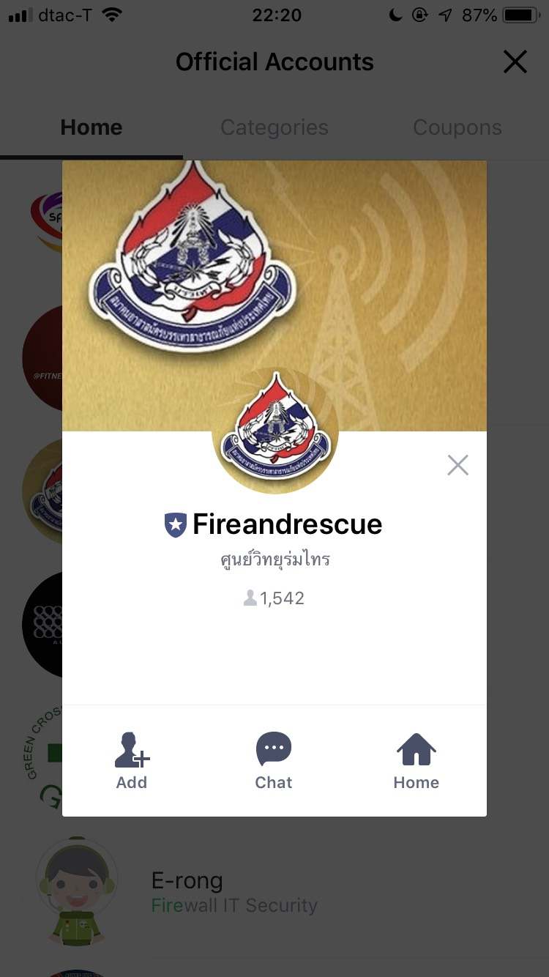
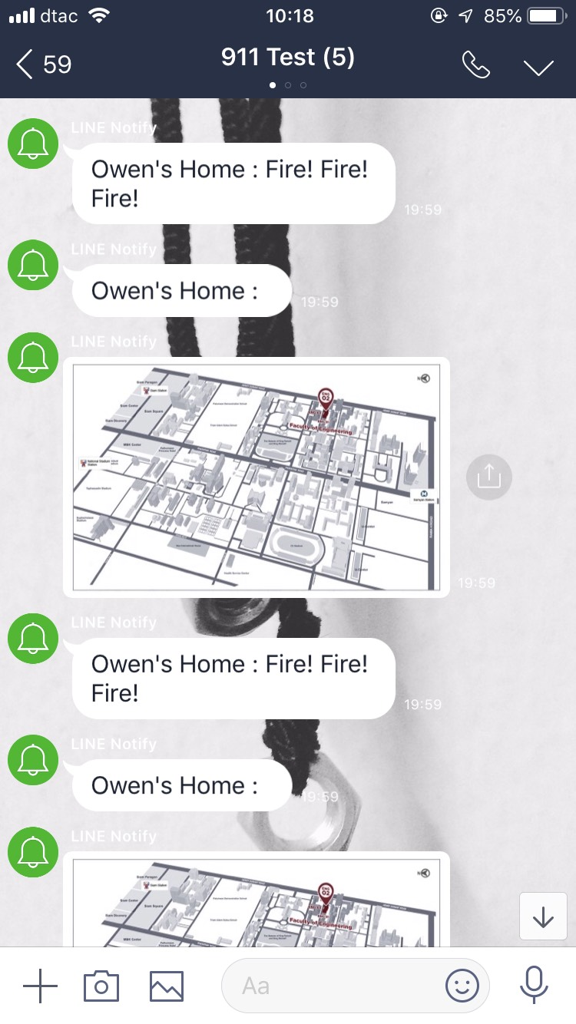
LEVEL 2
Send the alert messages to personal account and rescue official account that also include map

Slide 10
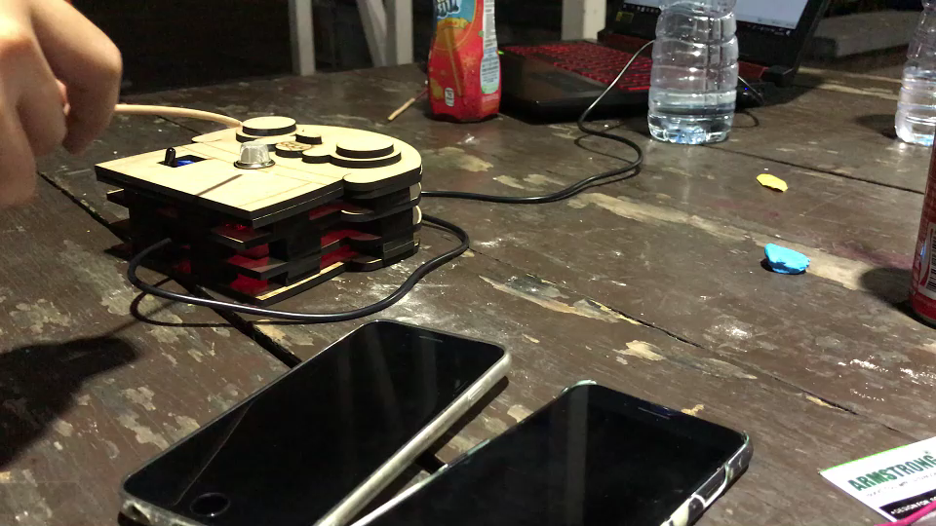
Both flame and smoke

Slide 11
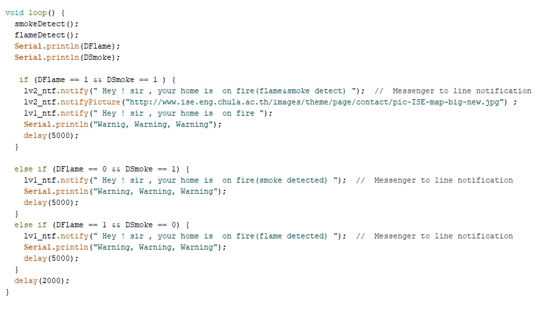
CODE
Read more : https://github.com/nessessence/CP-FireDetector101

Slide 12
STENGTH
Easy to install and use
Low price
Suitable for people every ages
Attractive design
Send alert messages to smartphone
Send home location to rescuers

Slide 13
HOW CAN WE IMPROVE PROJECT
In case that there is fire and we lose internet connection or not read the LINE’s alert messages, our product will directly call 199 for rescue.

